Slide 1
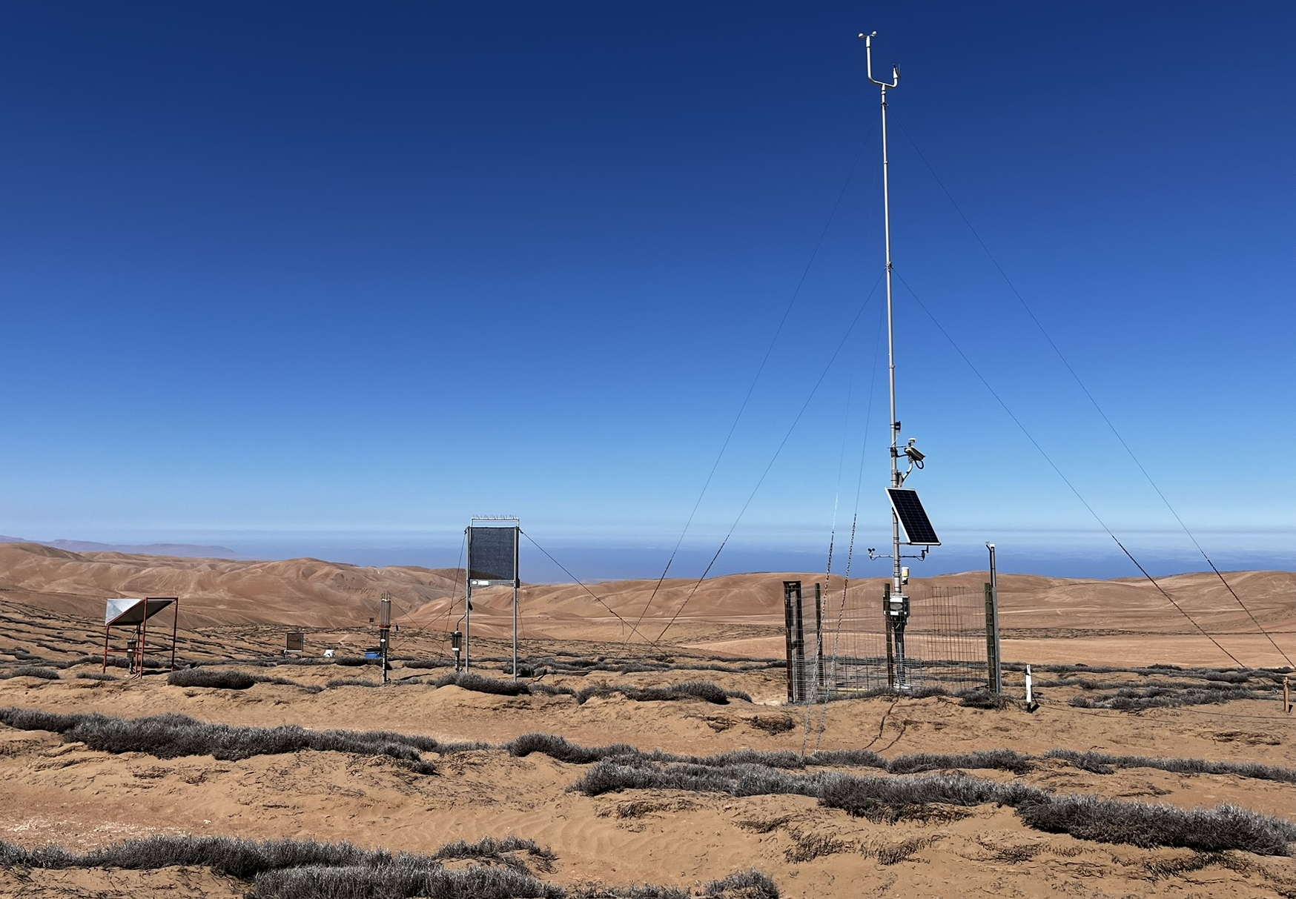

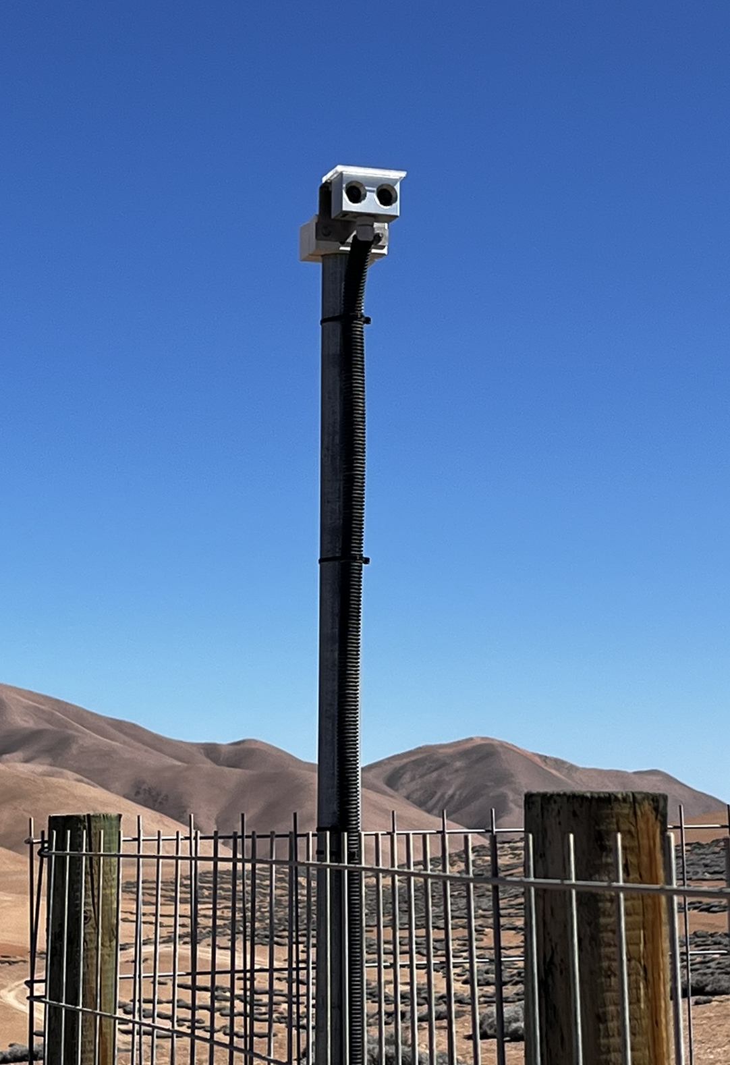
Estación OYA1211, Cerro Oyarbide
Rocío
SFC
VIS
Niebla
Oceano
SDC
Tillandsia landbeckii

Slide 2
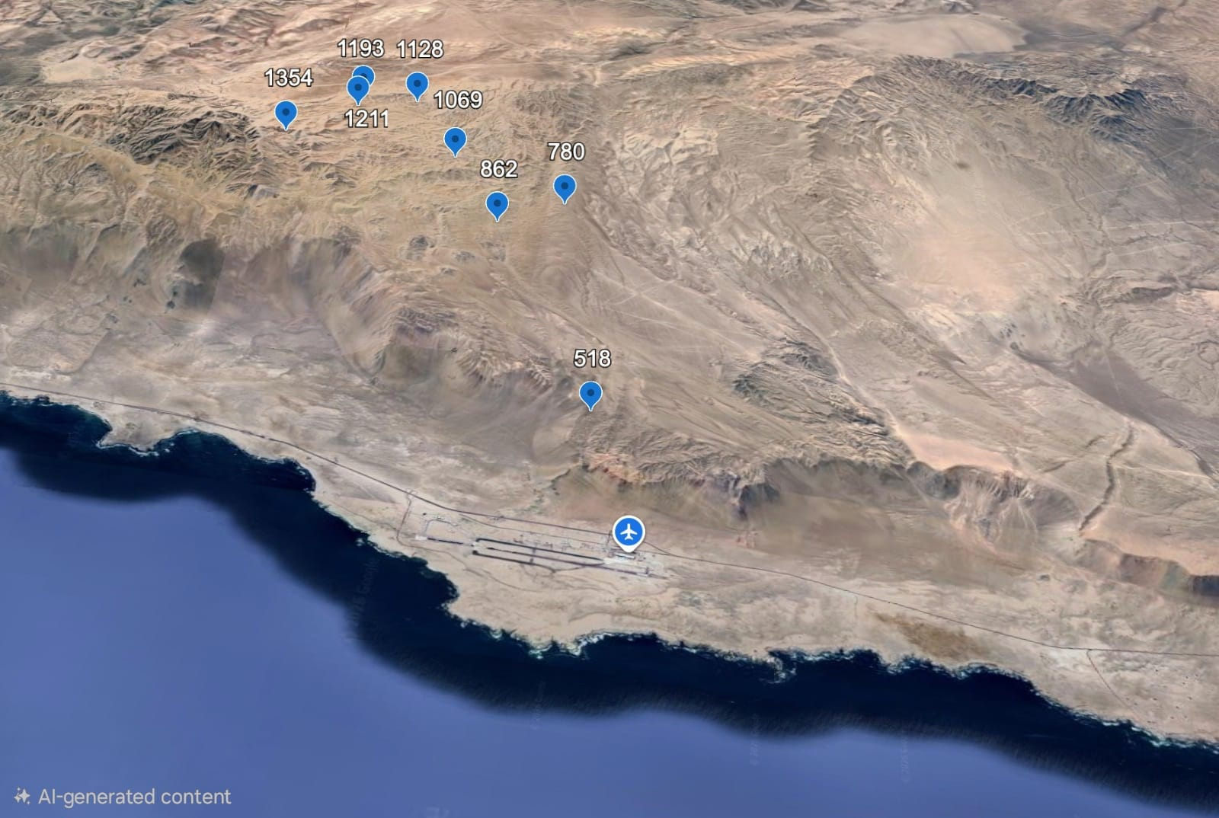


Slide 3

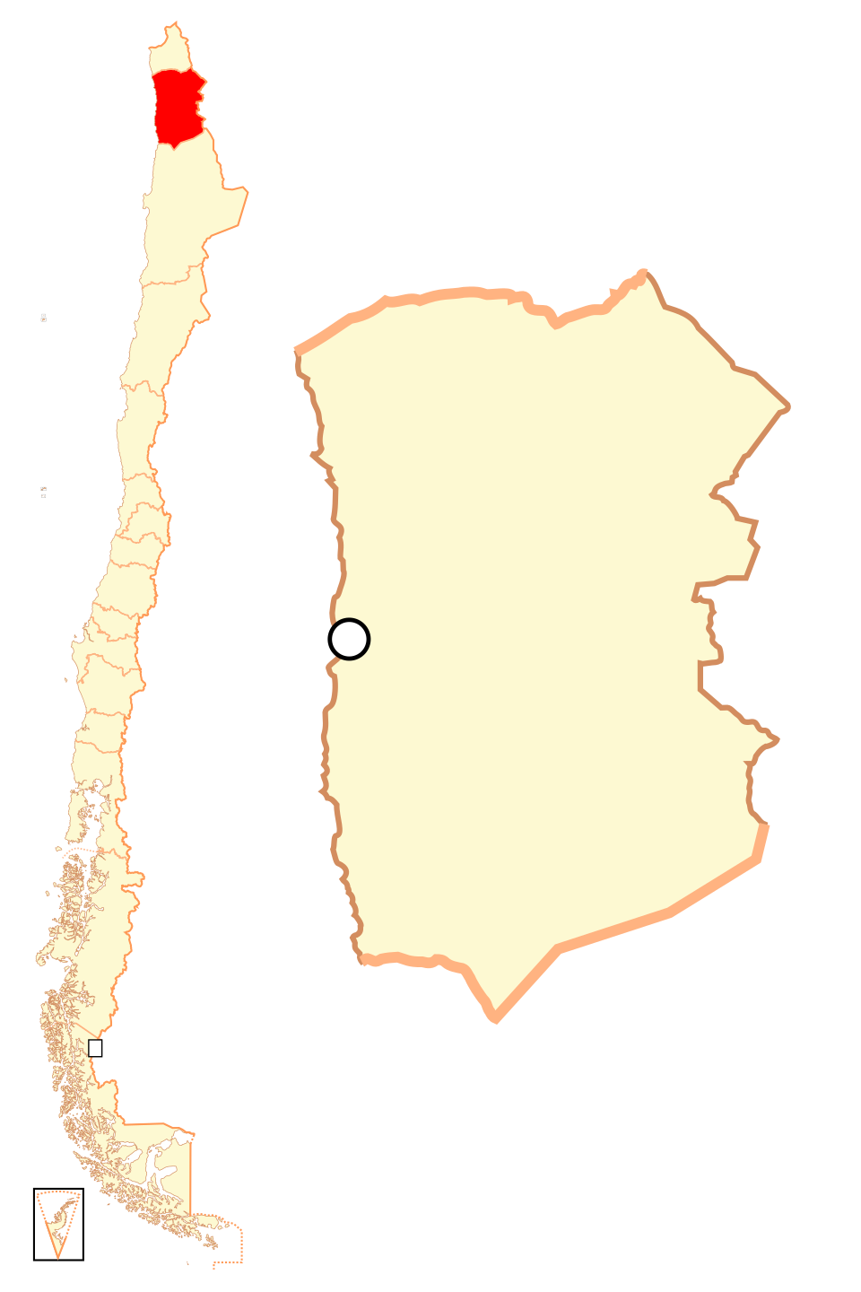
1193m (-20.49°, -70.06°)
1128m (-20.50°, -70.06°)
1354m
(-20.48°,
-70.08°)
1211m
(-20.49°,
-70.06°)
1069m (-20.51°, -70.08°)
780m (-20.53°, -70.09°)
862m
(-20.52°, -70.10°)
518m (-20.54°, -70.15°)
48m (-20.53° y -70.18°)

Slide 4
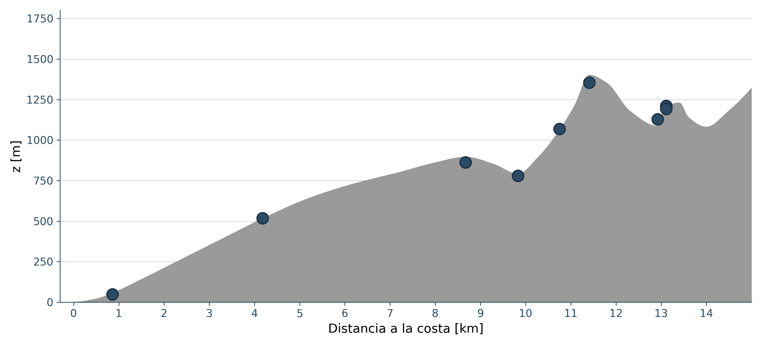
(A)
1193m (-20.49°, -70.06°)
(C) OYA1211
1128m (-20.50°, -70.06°)
1354m
(-20.48°, -70.08°)
1211m
(-20.49°,
-70.06°)
1069m (-20.51°, -70.08°)
780m (-20.53°, -70.09°)
862m
(-20.52°, -70.10°)
Dew
Ocean
518m (-20.54°, -70.15°)
SFC
Fog
VIS
Fog
SDC
48m (-20.53° y -70.18°)
Tillandsia landbeckii
(B)
(D)
OYA1354
48m (-20.53° y -70.18°)
OYA1211
OYA1069
OYA1193
OYA862
OYA1128
OYA780
OYA518
AIRPORT
Offshore distance [km]

Slide 5
(A)
1193m (-20.49°, -70.06°)
(C) OYA1211
1128m (-20.50°, -70.06°)
1354m
(-20.48°, -70.08°)
1211m
(-20.49°,
-70.06°)
1069m (-20.51°, -70.08°)
780m (-20.53°, -70.09°)
862m
(-20.52°, -70.10°)
Dew
Ocean
518m (-20.54°, -70.15°)
SFC
Fog
VIS
Fog
SDC
48m (-20.53° y -70.18°)
Tillandsia landbeckii
(B)
(D)
OYA1354
48m (-20.53° y -70.18°)
OYA1211
OYA1069
OYA1193
OYA862
OYA1128
OYA780
OYA518
AIRPORT
Offshore distance [km]

Slide 6
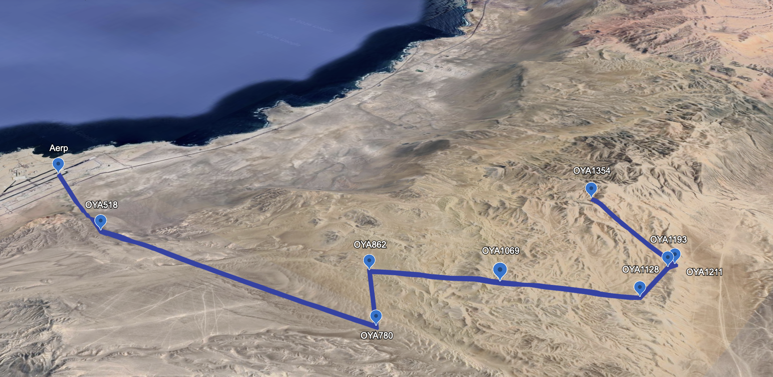
-20.48°
-70.18°
Latitude
Fog
-20.54°
Longitude
-70.06°

Slide 7
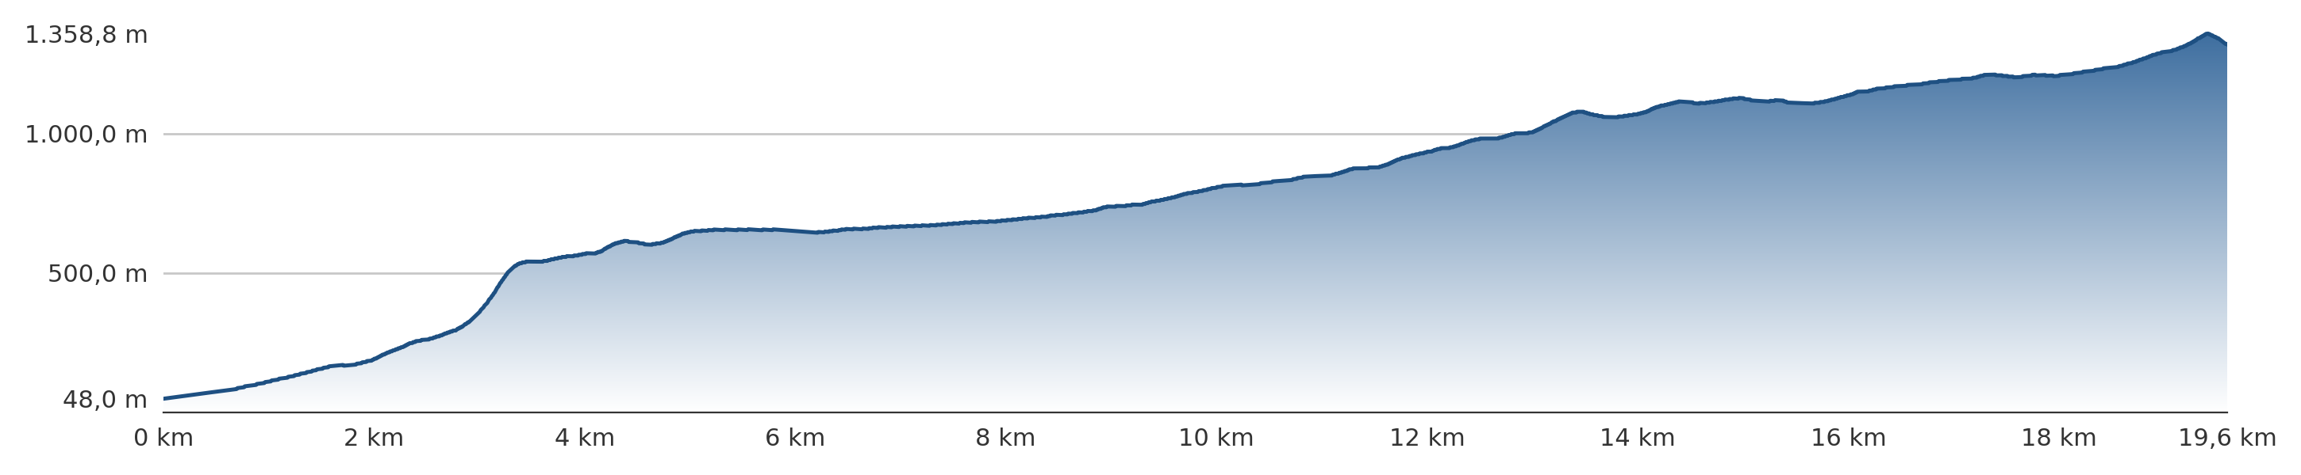
(A)
-20.48°
-70.18°
(C) OYA1211
Latitude
Fog
-20.53°
Longitude
-70.06°
Ocean
Fog
Dew
SFC
VIS
SDC
OYA1128
OYA1193
OYA1211
OYA1354
OYA1069
Tillandsia landbeckii
OYA780
OYA862
OYA518
AERP.
(B)
Cumulative along-transect distance [km]

Slide 8
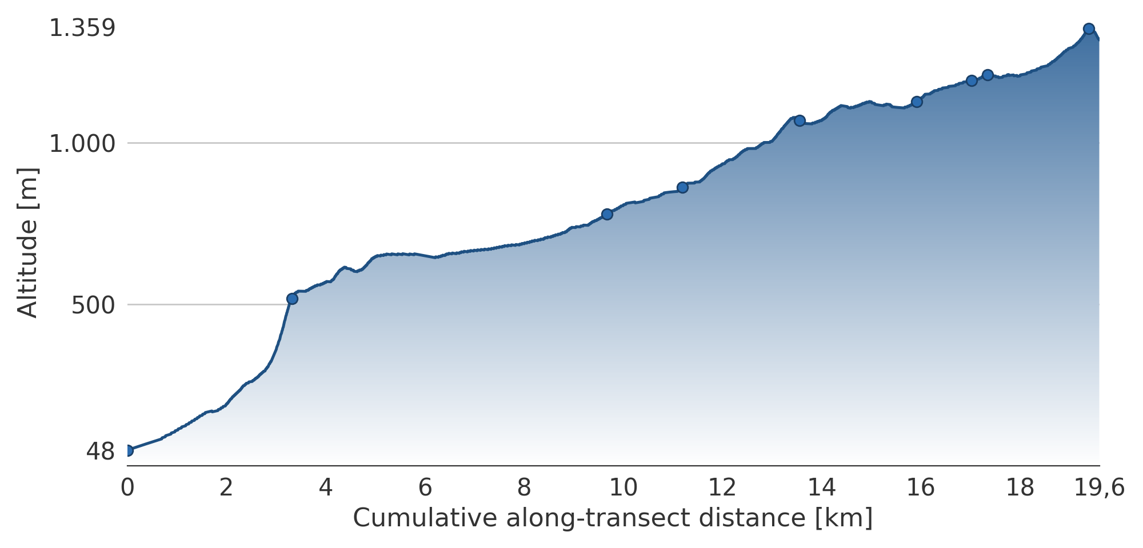
(A)
-20.48°
-70.18°
Latitude
Fog
Longitude
(C) OYA1211
-20.53°
AERP.
OYA1354
OYA518
-70.06°
OYA862
OYA1069
OYA1193
OYA1128
OYA1211
OYA780
Dew
Ocean
(B)
Fog
VIS
OYA1354
SFC
OYA
1211
OYA
1193
SDC
OYA1128
OYA1069
OYA862
Tillandsia landbeckii
OYA780
OYA518
AERP.

Slide 9
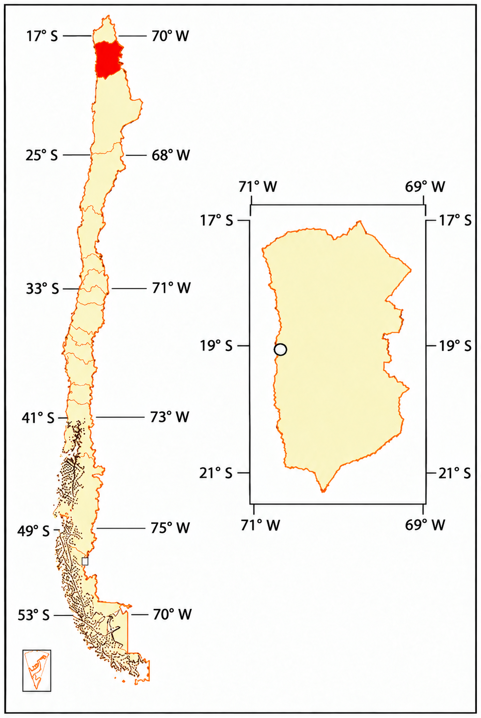
(A)
-20.48°
-70.18°
(C) OYA1211
Latitude
Fog
Longitude
-20.53°
Dew
AERP.
OYA1354
Fog
Ocean
OYA518
-70.06°
SFC
OYA1193
SDC
OYA862
OYA1069
VIS
OYA1128
OYA1211
Tillandsia landbeckii
OYA780
(B)
OYA1354
(D)
OYA
1211
OYA
1193
OYA1128
OYA1069
OYA862
OYA780
OYA518
AERP.

Slide 10
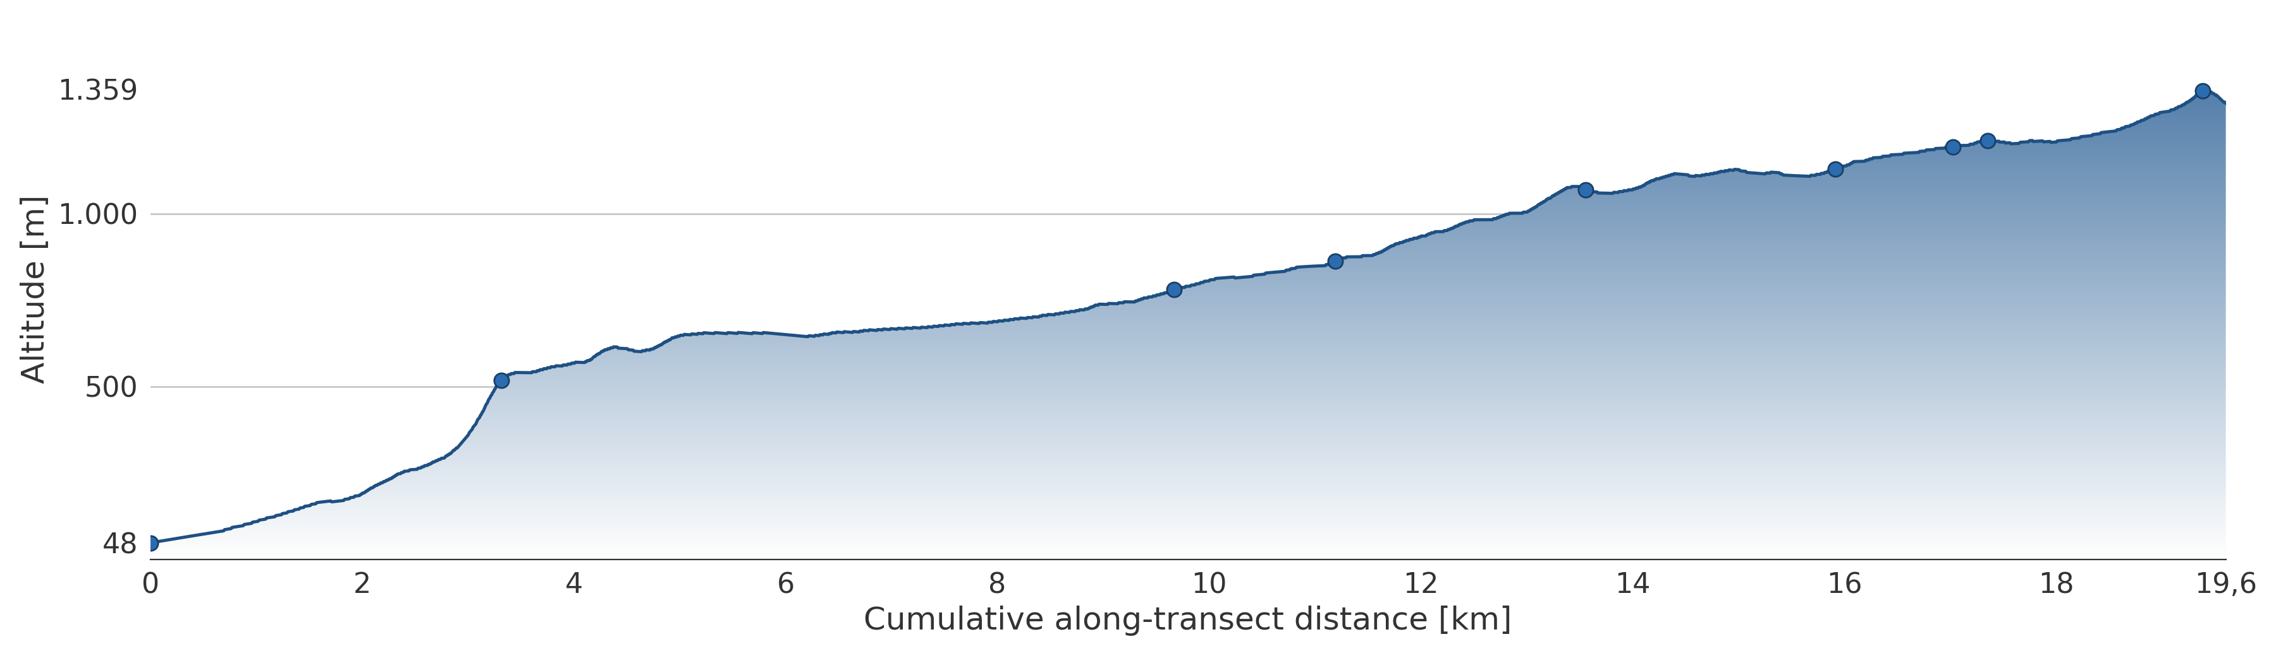
(A)
-20.48°
-70.18°
(C) OYA1211
Latitude
Fog
Longitude
-20.53°
Dew
OYA48
OYA1354
Fog
Ocean
OYA518
-70.06°
SFC
OYA1193
SDC
OYA862
OYA1069
VIS
OYA1128
OYA1211
Tillandsia landbeckii
OYA780
(B)
OYA1354
OYA
1193
OYA
1211
OYA1069
OYA1128
OYA780
OYA862
OYA518
OYA48

Slide 11
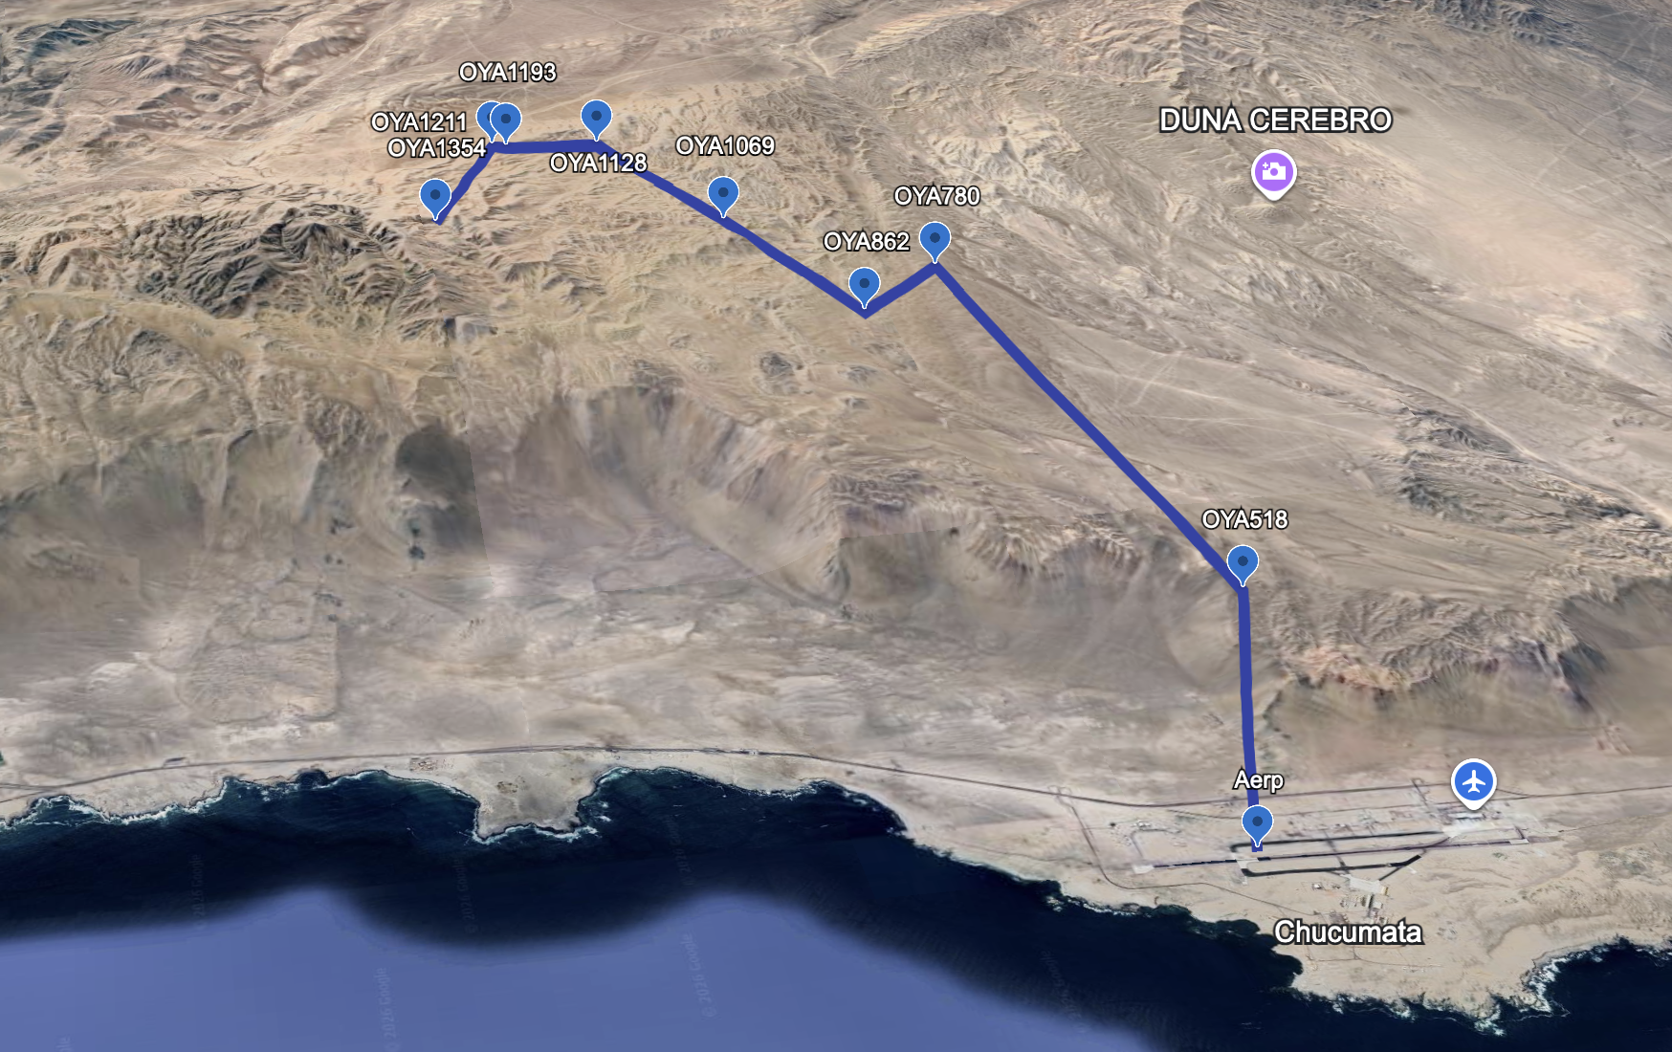
LATITUD

Slide 12
Estación OYA1211, Cerro Oyarbide
Rocío
SFC
VIS
Niebla
Oceano
SDC
Tillandsia landbeckii

Slide 13
